Slide 1
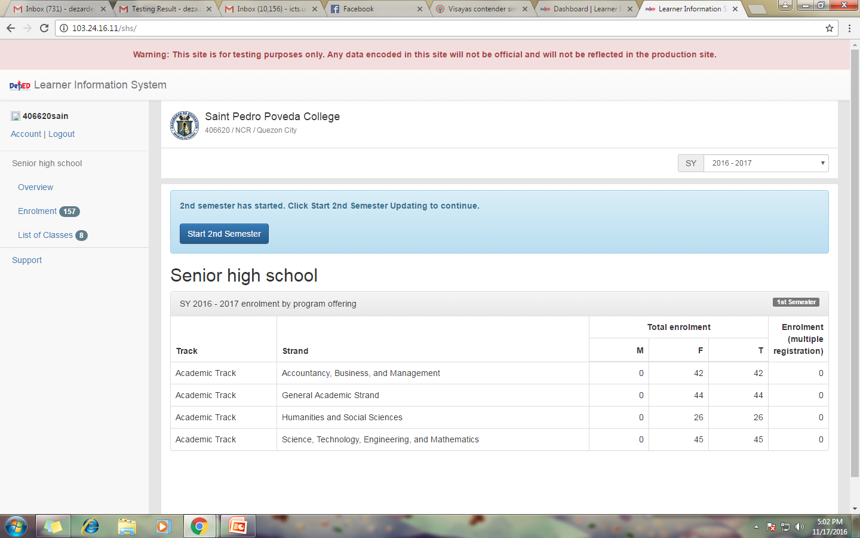
Overview Page (Private)
1
Click Start 2nd Semester

Slide 2
Overview Page (Private)
Set the date of start of class for the 2nd Sem
2
Click Start 2nd Semester
Click OK to confirm

Slide 3
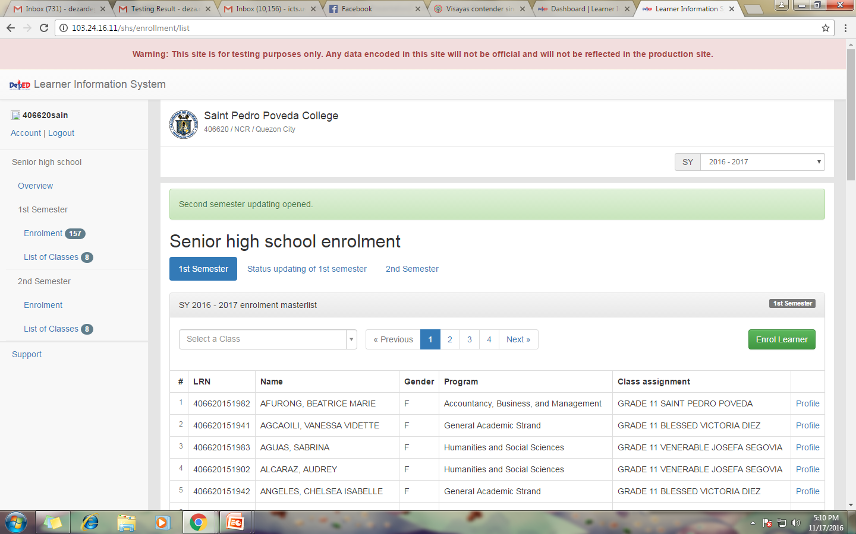
1st Semester Tab (Private)
Confirmation message shall display
1
Click ENROL LEARNER for the 1st Semester
Displayed 1st Semester Masterlist

Slide 4
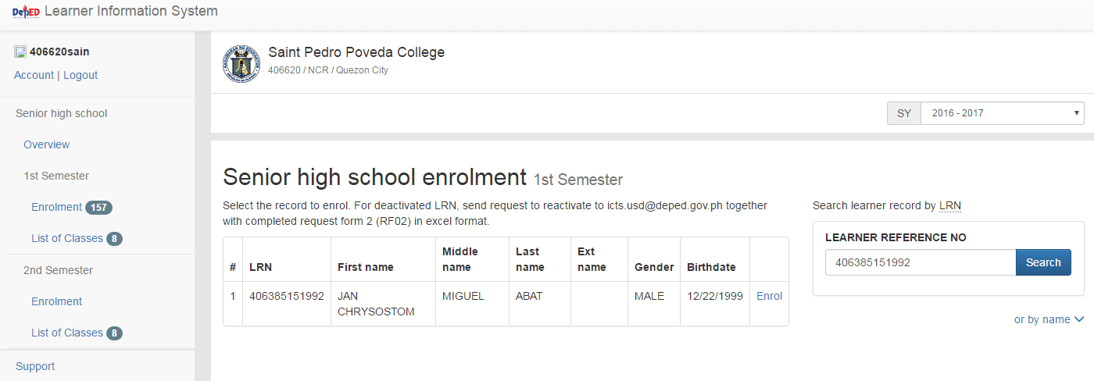
1st Semester Tab (Private)
Either search by LRN or by Last Name and First Name
2
Click on the Search button
3
Click on the Enrol

Slide 5
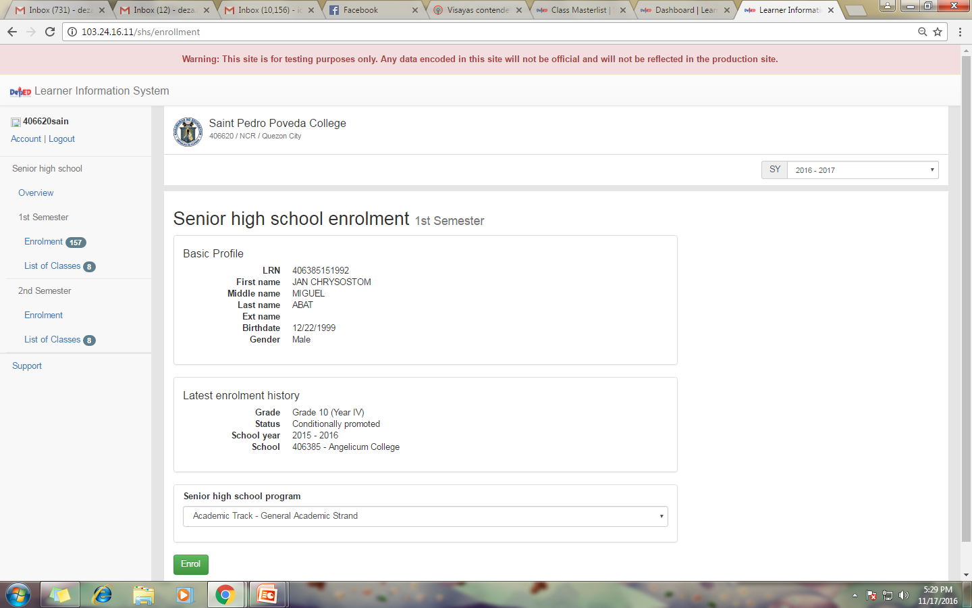
1st Semester Tab (Private)
The details of the learner and last enrollment history display
4
Click on the Enrol Button

Slide 6
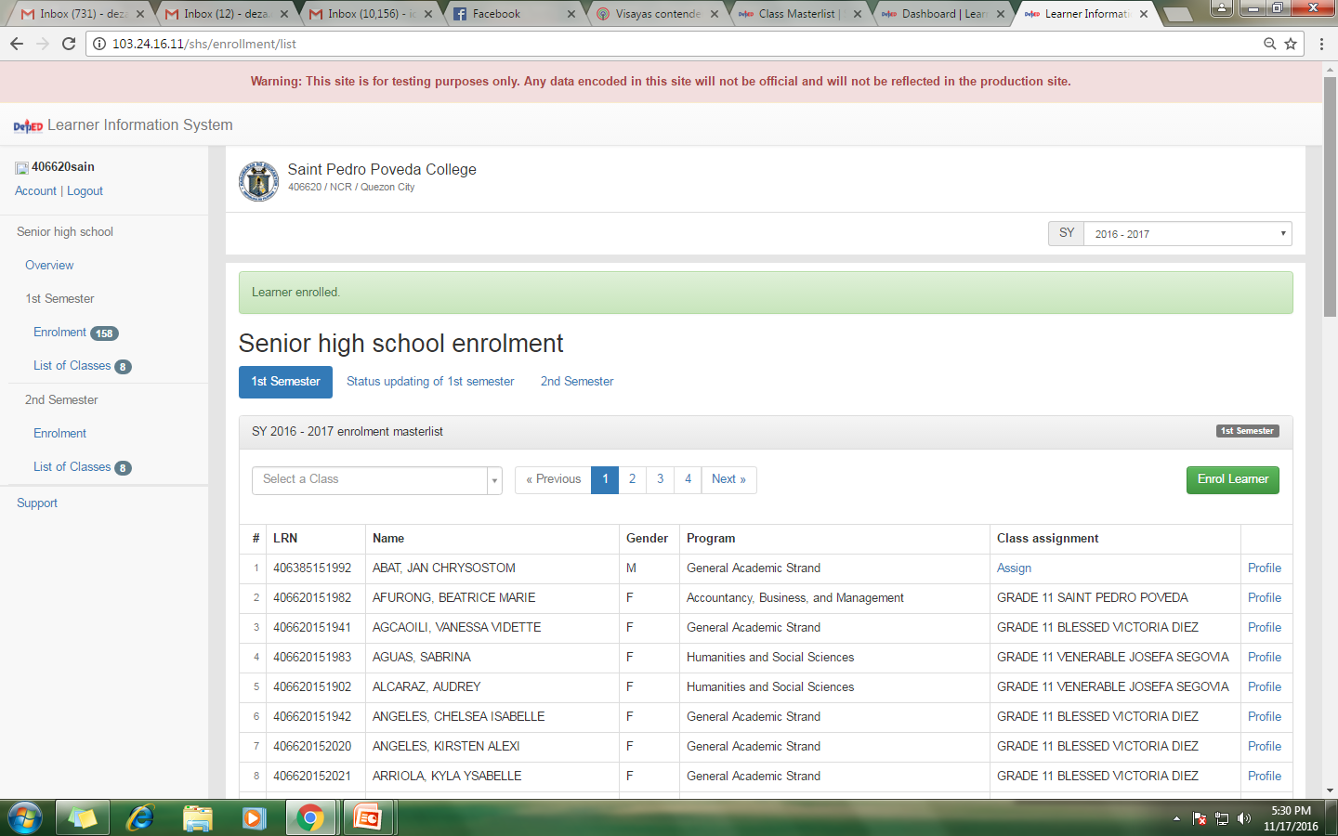
1st Semester Tab (Private)
Confirmation message shall display that the learner already enrolled in 1st Semester
5
Click Assign

Slide 7
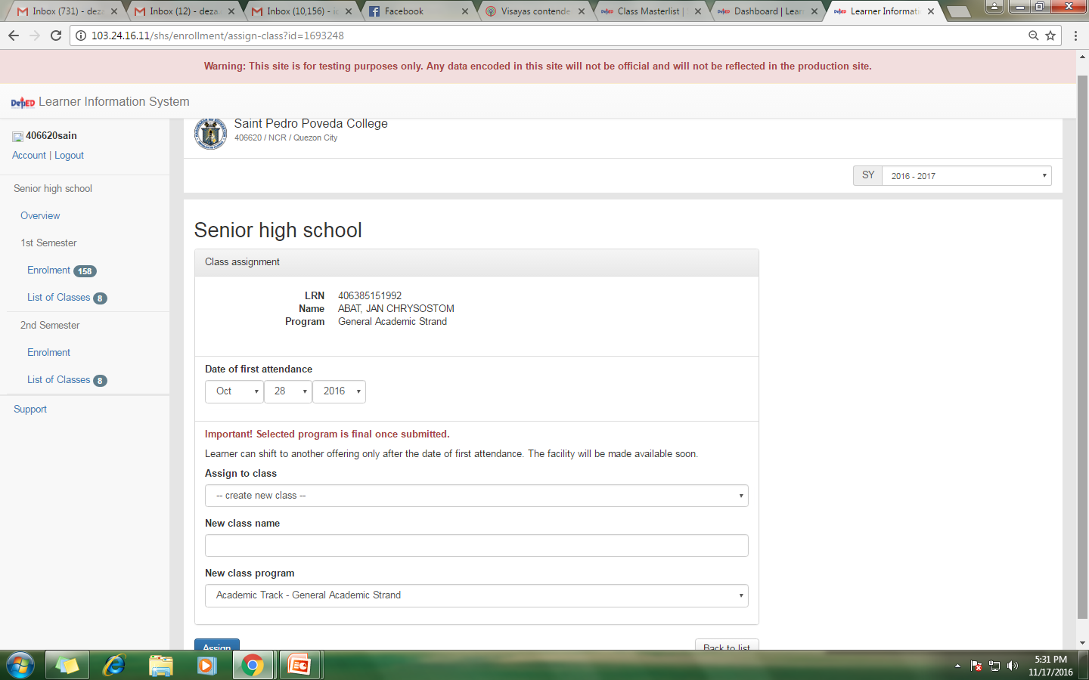
1st Semester Tab (Private)
Input the date of first attendance (1st Sem) of the learner and assign to a class
6
Click Assign Button

Slide 8
1st Semester Tab (Private)
Confirmation message shall display
Already enrolled (1st Semester)

Slide 10
Status Updating of 1st Sem Tab (Private)
1
Click on the Update button

Slide 11
Status Updating of 1st Sem Tab (Private)
Choose Status
a
In School
b
No Longer in School (NLS)
2

Slide 12
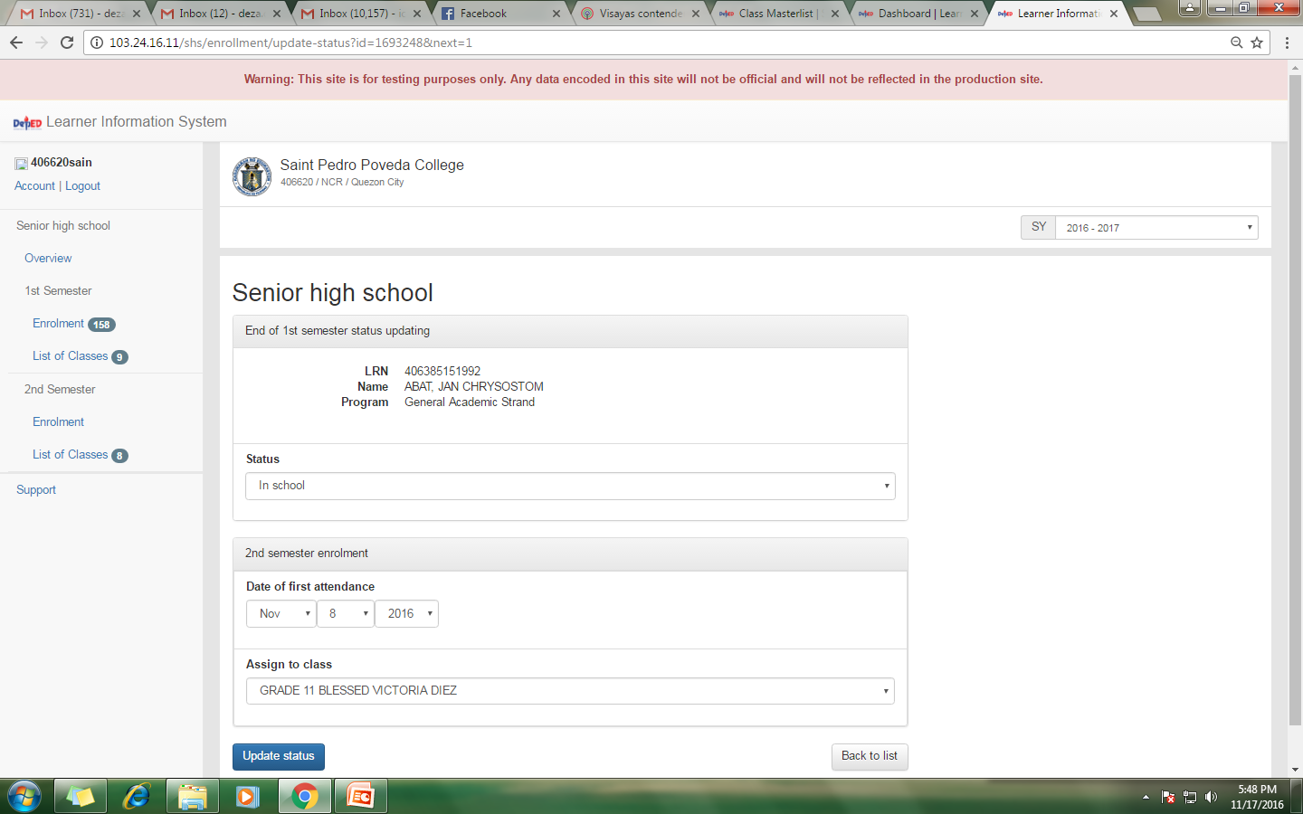
Status Updating of 1st Sem Tab (Private)
a
In School
Input the date of first attendance for the 2nd semester enrollment
Click Update Status

Slide 13
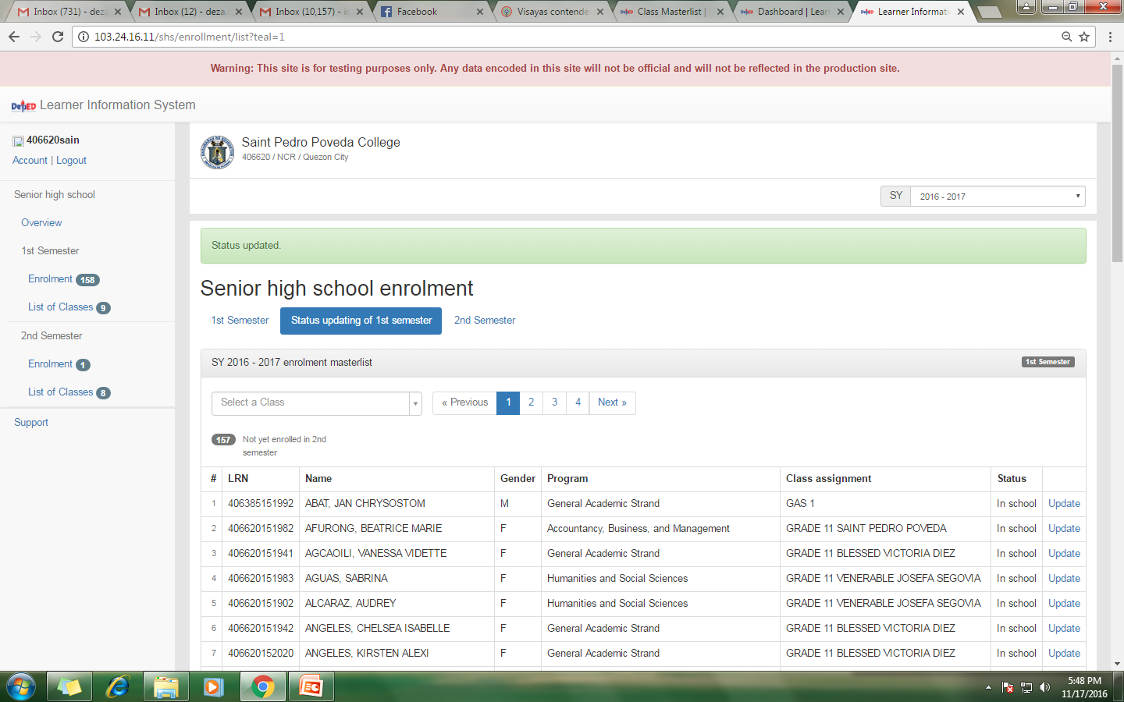
Status Updating of 1st Sem Tab (Private)
Confirmation message shall display
Learner already enrolled in 2nd semester

Slide 14
Status Updating of 1st Sem Tab (Private)
b
No longer in school
Input the date of last attendance for the 1st semester and choose reason
Click Update Status

Slide 15
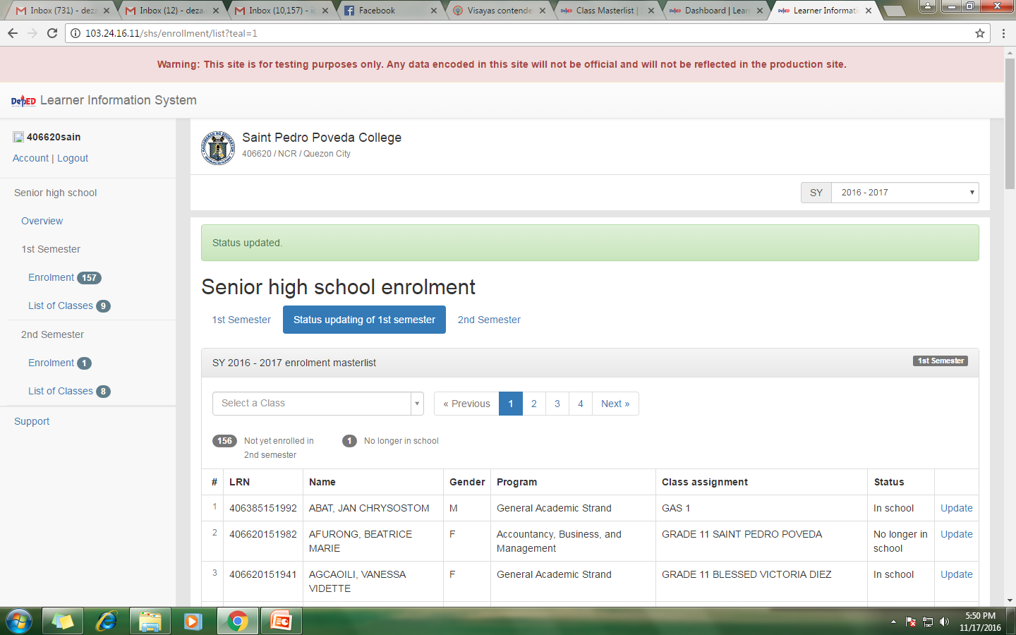
Status Updating of 1st Sem Tab (Private)
Confirmation message shall display

Slide 16
Status Updating of 1st Sem Tab (Private)

Slide 17
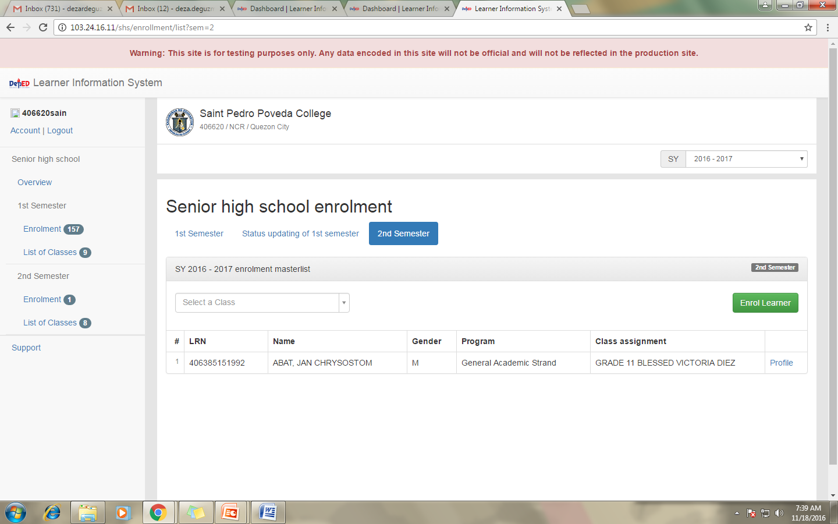
2nd Semester Tab (Private)
1
Click ENROL LEARNER for the 2nd Semester

Slide 18
2nd Sem Tab (Private)
Either search by LRN or by Last Name and First Name
Click on the Search Button
2
Click on the Enrol Button
3

Slide 19
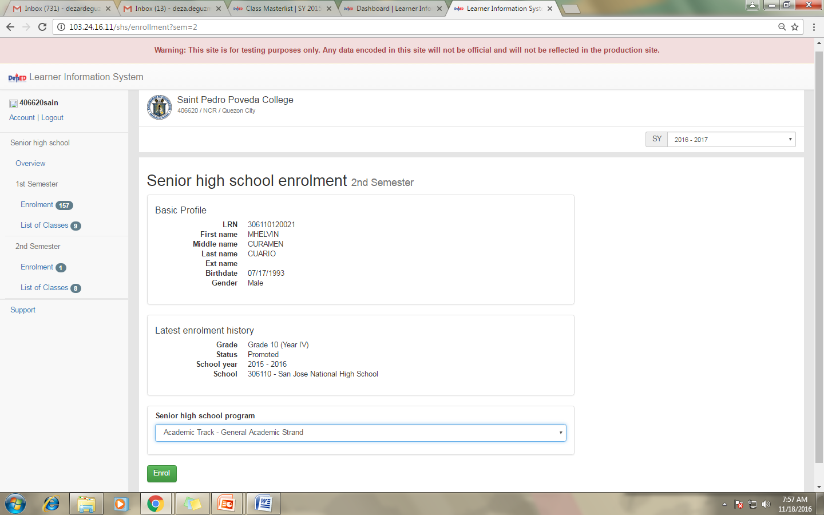
2nd Sem Tab (Private)
The details of the learner and last enrollment history shall display
4
Click on the Enrol Button

Slide 20
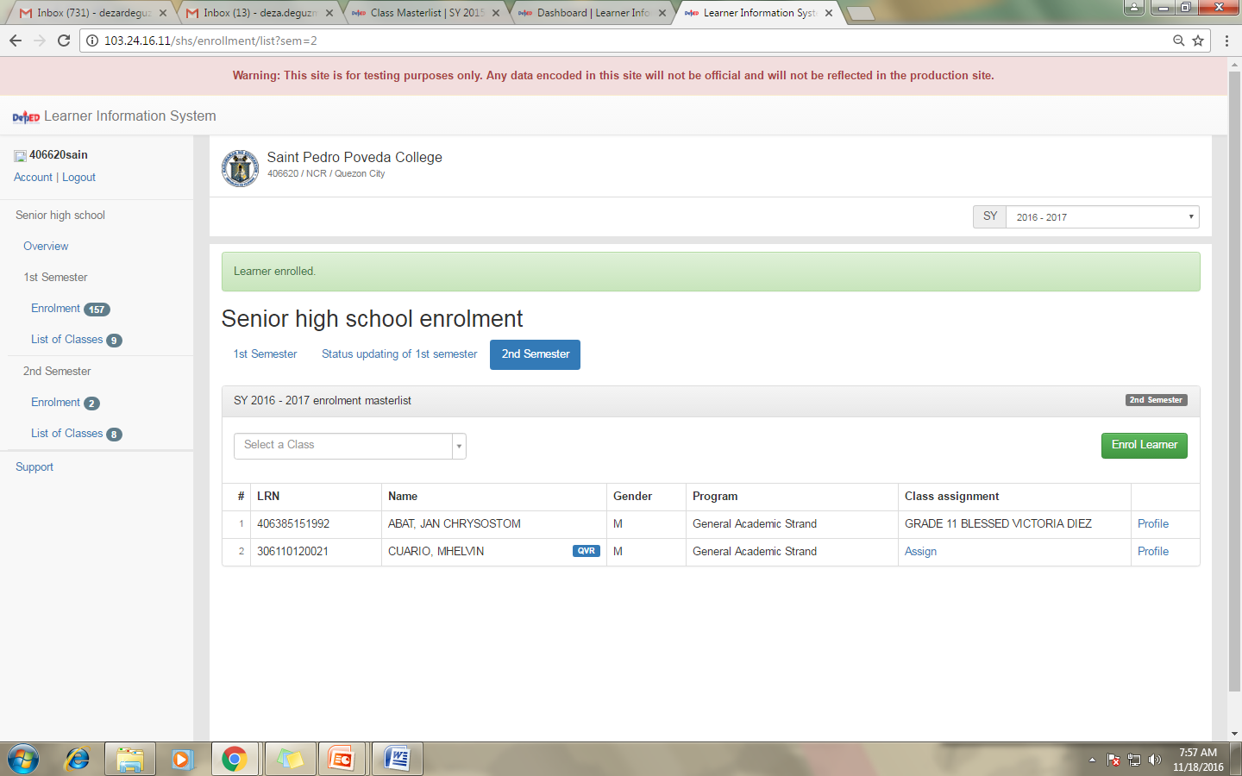
2nd Sem Tab (Private)
Confirmation message shall display
Already enrolled (2nd Semester)

